Slide 1
Data Science Tools and Environments
Steve Johnson, PhD, Assistant Professor, Institute for Health Informatics, University of Minnesota
June 5, 2019

Slide 2
Data Science Tools
Languages
Python, R, SQL
Technologies
Cloud, Hadoop, No SQL, Notebooks
Environments
Desktop, Google, Amazon, Microsoft
Notes:
How do things get done in Data Science?
languages – tell what to do
technologies – allow you to do it
environments – the place to do it
Not meant to be exhaustive list

Slide 3
Most Popular Data Science Languages (2018)
Source: https://towardsdatascience.com/the-most-in-demand-skills-for-data-scientists-4a4a8db896db

Slide 4

Python
Python is an interpreted, high-level, dynamically typed, general-purpose programming language
Created by Guido van Rossum in 1991
Emphasizes code readability (using whitespace) and aims to help programmers write clear, logical code for small and large-scale projects
Source: https://en.wikipedia.org/wiki/Python_(programming_language)

Slide 5
Python Ecosystem
Install
Using standard Python - https://www.python.org/downloads/
Using Anaconda (recommended) - https://www.anaconda.com/
Programming Environment
Spyder - https://www.spyder-ide.org/
PyCharm Community Edition - https://www.jetbrains.com/pycharm/
High-performance
Cython – Compile Python to C - https://cython.org/
PyPy – Just-in-time compiled Python - https://pypy.org/
Libraries
Python Package Index - https://pypi.org/
Anaconda - https://www.anaconda.com/
Key data science packages: matplotlib, pandas, scikit-learn

Slide 6
Python
Strengths
Free, Open Source
Many libraries / packages
Full featured programming language
Focused on Data Scientists with Computer background
Weaknesses
Slow compared to compiled languages (Java, C++)
Dynamically typed (run-time errors)

Slide 7
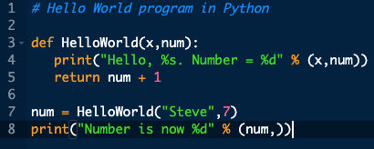
Python: Example
Output:
Hello, Steve. Number = 7
Number is now 8

Slide 8

R
R is an integrated suite of software facilities for data manipulation, calculation and graphical display. It includes
an effective data handling and storage facility,
a suite of operators for calculations on arrays, in particular matrices,
a large, coherent, integrated collection of intermediate tools for data analysis,
graphical facilities for data analysis and display either on-screen or on hardcopy, and
a well-developed, simple and effective programming language which includes conditionals, loops, user-defined recursive functions and input and output facilities.
Source: https://www.r-project.org/about.html

Slide 9
R Ecosystem
Install –
Using R-project - https://www.r-project.org/
Using Anaconda (recommended) - https://www.anaconda.com/
Programming environment
RStudio – https://www.rstudio.com/
High-performance
Microsoft R (Revolution Analytics) - https://blog.revolutionanalytics.com/
Libraries
CRAN - https://cran.r-project.org/
Key data science packages: dplyr, ggplot2, mlr, caret

Slide 10
R
Strengths
Free, Open Source
Many libraries / packages
Good data visualization
Focused on Data Scientists with Statistical background
Weaknesses
Steep learning curve
Memory constrained, not good for Big Data

Slide 11
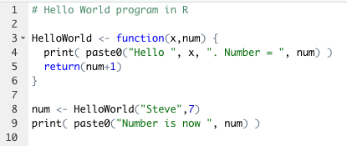
R Example
Output:
[1] "Hello Steve. Number = 7"
[1] "Number is now 8"
Notes:
Functional, not as consistent a programming language as Python (procedural)

Slide 12
SQL
Database specific language used to access and modify data in a database
Originally developed by Edgar Codd for relational databases (1970)
SQL is declarative
Most databases have procedural extensions to make SQL a full programming language

Slide 13
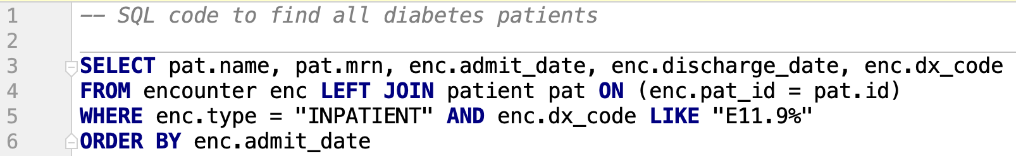
SQL
Notes:
UPDATE, INSERT, DDL

Slide 14
Technologies
Cloud Computing
Distributed processing (Hadoop)
No SQL
Notebooks (Jupyter)

Slide 15
Hadoop
Hadoop
Apache software
Distribute large data across clusters of computers
Fault tolerant
MapReduce
Divide compute job into a “Map” phase and “Reduce” phase
Data Access
Spark – general compute engine for Hadoop for ETL, ML and graph computation
Cassandra – scalable database with no single point of failure
HIVE – data warehouse providing ad hoc query

Slide 16
No SQL
Store data without a schema
Key / Value pairs (aggregated into Documents)
Scalable, distributed and high-performance
Query using distributed processing
Examples: MongoDB, DynamoDB, Bigtable, Neo4j
Source: https://www.kdnuggets.com/2016/07/seven-steps-understanding-nosql-databases.html

Slide 17
Jupyter Notebooks
Juyter notebooks is open source software that enables creation and sharing of data science programs and documents
Strengths
Works for multiple languages including Python, R, SQL and shell commands
Document the data science process
Reproduce all steps
Enhance productivity and reuse
Share your work
Weaknesses
Version control, debugging, long running tasks

Slide 18
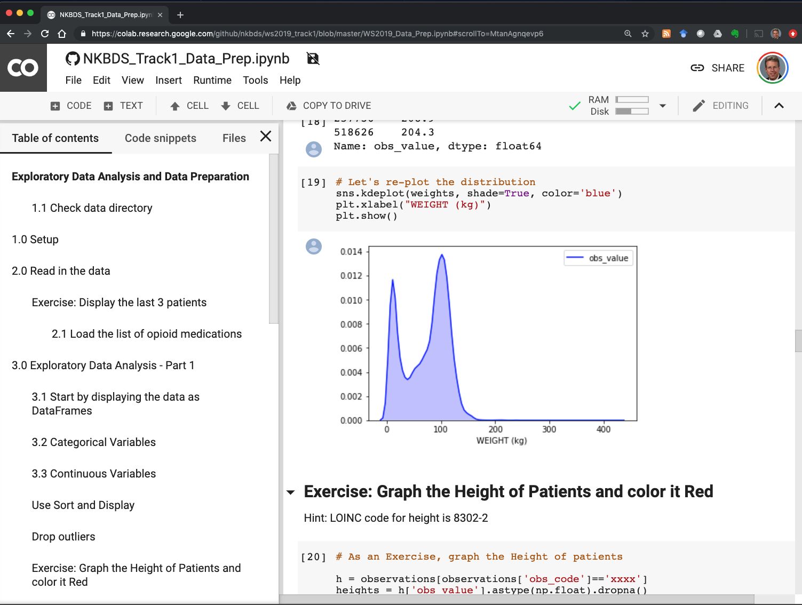
Jupyter Notebook: Example

Slide 19
Environments
Data science in the cloud:
Advantages
Choose high-performance hardware and GPUs
Parallel execution across multiple machines
Easy “tear-down” and “scale-up”
Cost effective for research, pilots
High security, availability and performance
Disadvantages
Can be costly for high-volume, production systems
Vendor lock-in
Must move data to the cloud
Notes:
Microsoft Machine Learning Studio

Slide 20
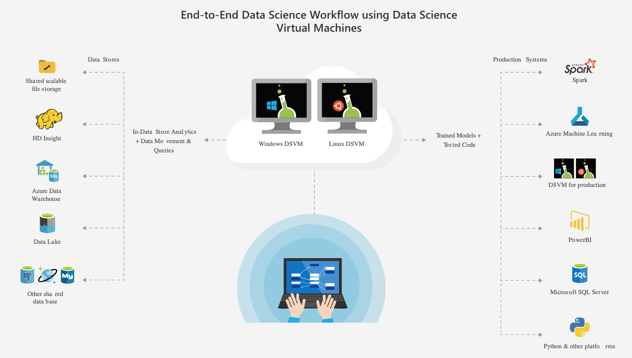
Environments: Microsoft
Microsoft Data Science Virtual Machine
Pre-configured with everything in the cloud

Slide 21
Environments: Amazon
Data Science with Amazon SageMaker and a Data Lake
Notes:
More of a define process vs a workstation

Slide 22
Environments: Google
Google Cloud Datalab and Colab

